Slide 1

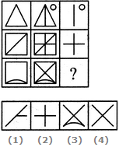
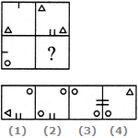
Reasoning PYQ
1. Select a suitable figure from the four alternatives that would complete the figure matrix.
A. 1
B. 2
C. 3
D. 4
2. Select a suitable figure from the four alternatives that would complete the figure matrix.
A. 1
B. 2
C. 3
D. 4

Slide 2
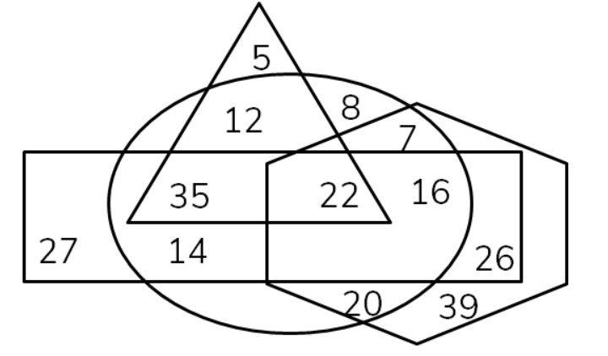
Reasoning PYQ
Q3. In the following diagram, the triangle stands for ‘males’, the circle for ‘doctors’, the rectangle for ‘government employed', the hexagon for ‘corona warriors’. The numbers in different segments show the number of persons for that segment. How many government-employed doctors are either corona warriors or males or both?
A. 22
B. 73
C. 35
D. 38

Slide 3
Reasoning PYQ
Q4. Nehal, Iqbal, Ronit, Malini and Harbhajan participate in any one of the five activities i.e Quiz, Singing, Dance, Debate and Mimicry. Ronit participates in Singing. Harbhajan does not participate in Debate and Mimicry. Malini does not participate in Mimicry. Iqbal participates in Quiz. Who participates in Debate?
A. Malini
B. Nehal or Malini
C. Nehal
D. Cannot be determined

Slide 4
Reasoning PYQ
Q5. Given below is a question followed by two statements I and II, each containing some information. Decide which of the statements are sufficient to answer the question that follows.
How many Rs. would Shalini need to spend to buy 11 pencils and 14 pens?
Statements:
I. Shalini spent an amount of Rs. 201 to buy 15 pencils and 12 pens.
II. Shalini spent an amount of Rs. 121 to buy 7 pencils and 9 pens.
A. The combination of statements I and II are not sufficient.
B. Statement II alone is sufficient.
C. Statement I alone is sufficient.
D. The combination of statements I and II are necessary.

Slide 5
Reasoning PYQ
Q6. Seven friends O, P, Q, R, S, T and U are standing in a row.
1. Q is to the immediate right of U
2. P is between T and S
3. O is immediate right of Q who is immediate left of S
4. U is between Q and R
Who is exactly in the middle of the row?
A. R
B. Q
C. S
D. O

Slide 6
Reasoning PYQ
Q7. In a row, seven people are standing for march past.
I. B is standing right to A and left to C.
II. D is standing left to E but right to C.
III. F is standing right to E and left to G.
Who is standing in the middle of the row?
A. D
B. Either B or G
C. A
D. Either C or E

Slide 7
Reasoning PYQ
Q8. Following are the criteria for admitting a student to a post-graduation course in a reputed college.
The student must
I. have passed XII standard with more than 50% marks.
II. have secured at least 60% marks at graduation level.
III. be of at least 21 years of age or more as on 01.01.2020.
IV. have secured more than 55% marks in the entrance test.
In the case of the student, who satisfies all other criteria except,
a) (II) above, but has obtained at least 70% marks in the entrance test, should be referred to the HOD.
b) (I) above, but has obtained at least 80% marks at graduation level, should be referred to the Dean.
Nisha was born on 08.04.1998. She secured 65% marks in XII standard, 70% marks in graduation and also scored 60% marks in the entrance test.
A. The student is not to be admitted.
B. The student is to be admitted.
C. The student is to be referred to the HOD.
D. The student is to be referred to the Dean.

Slide 8
Reasoning PYQ
9. A statement is followed by two assumptions numbered I and II.Consider the statement and decide which of the given assumption(s) is/are implicit in the statement.
Statement
Various governments across the world have issued strict guidelines for the public to wear masks and wash hands regularly to safeguard their health during covid-19 pandemic.
Assumptions
1.Covid-19 Pandemic is a serious health issue.
2. There are ways by which people can save themselves from Covid-19 pandemic.
A) Neither 1 nor 2 implicit B) Both 1 and 2 are implicit
C) Only 2 is implicit D) Only 1 is implicit

